Slide 1
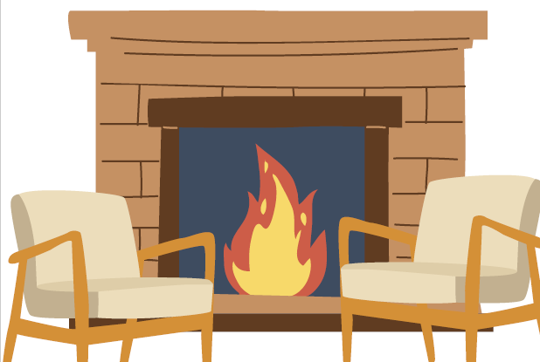
Dane Crisis Provider Network Fireside chat with APS
Date: August 20, 2025
Topic: Guardianship: how does it work?
Presenters:
Christin Bohleber, Shari Gray-Dorn
Notes:
HIT RECORD!!!!!
Hello,
Welcome to the Dane Crisis provider Network or DCPN first fireside chat. Today we will be chatting with Christin and Shari from Dane County’s Adult Protective Services Unit to understand more about guardianship and Behavioral Health

Slide 2
Housekeeping reminders
All Webinars are recorded and saved to the DCPN webpage for reference
Encourage you to have your video on if you can
There will be time for questions- please ensure that you are maintaining client confidentiality
Notes:
Reminder to please stay on mute unless speaking. IF so, please note that you can raise your hand during the Q&A portion of this webinar.

Slide 3
DCPN August 2025 webinar objectives
At the end of this webinar, we hope that participants will understand…
  how the Guardianship Process works
  what a guardian can and can’t do
  when Behavioral Health should consider pursuing a guardianship

Slide 4
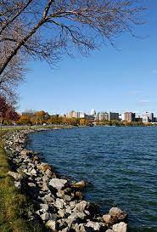
But first, understanding the landscape of guardianship in Dane County
2,354 people are under guardianship in Dane County
494 people are under protective placement in Dane County
APS filed 287 petitions in 2024- this includes petitions for guardianship, protective placement, successors, order to review conduct, etc.
APS authored 71 comprehensive evaluations (court reports) on petitions filed by third parties (hospitals, nursing homes, families who were able to hire a private atty, etc.)
Independent Evaluations are completed by Rise
Notes:
Now let’s welcome Christin and Shari

