Slide 1

Dane Crisis Provider Network Fireside chat
With APS Dementia Specialists
Date: March 20, 2026
Topic: Dementia and Crisis
Presenters: Becky Geoghegan-Smith
and Joy Schmidt

Slide 2
Housekeeping reminders
All Webinars are recorded and saved to the DCPN webpage for reference
Encourage you to have your video on if you can
There will be time for questions- please ensure that you are maintaining client confidentiality

Slide 3
DCPN March 2026 webinar objectives
At the end of this webinar, we hope that participants will understand…
Different types of dementia
How to tell if potentially dementia in someone with behavioral health needs
Ideas of how to support someone showing early signs of dementia
Available resources

Slide 4
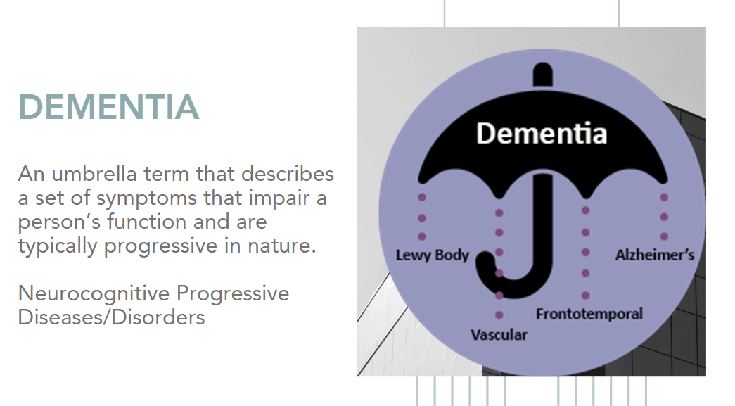

Slide 5
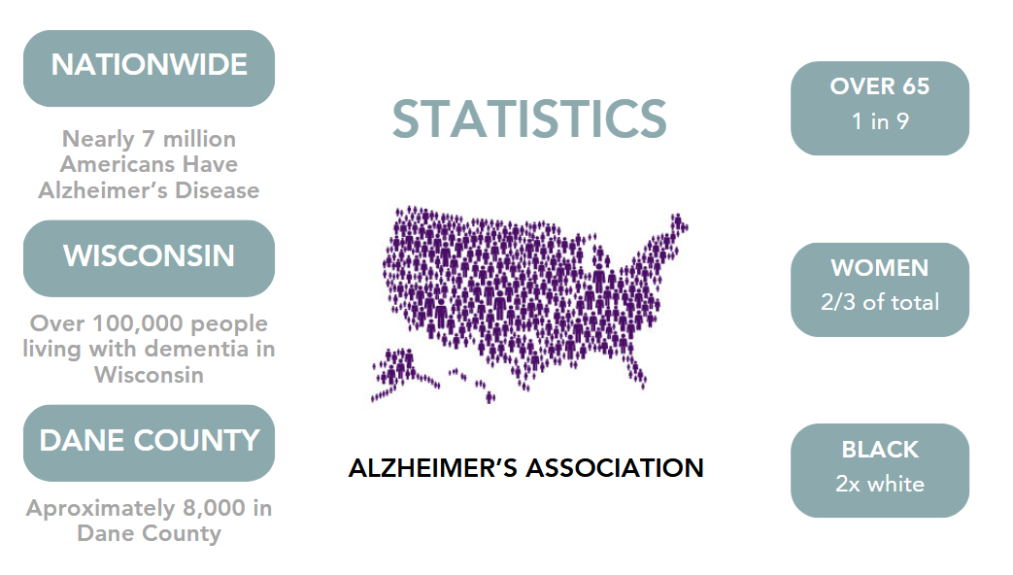
Alzheimer’s data

Slide 6
DCPN March 2026 links shared in the chat:
During the course of the webinar the following links were shared with participants:
https://care.nursing.wisc.edu/care-u-for-direct-care-staff/
https://www.daneadrc.org/Dementia/Caregiver-Support
https://www.daneadrc.org/documents/pdf/Resources/Caregiving/Memory-Cafes-ADRC-List.pdf

