Slide 1

Dane Crisis Provider Network Fireside chat
with the new Men’s Shelter
Date: September 23, 2026
Topic: Men’s Shelter
Presenters: Fares Fares and Patrick Duffie

Slide 2
Housekeeping reminders
All Webinars are recorded and saved to the DCPN webpage for reference
Encourage you to have your video on if you can
There will be time for questions- please ensure that you are maintaining client confidentiality

Slide 3
DCPN September 2026 webinar objectives
At the end of this webinar, we hope that participants will understand…
  How to connect someone you are supporting to the men’s shelter
  How to best partner with the shelter

Slide 4
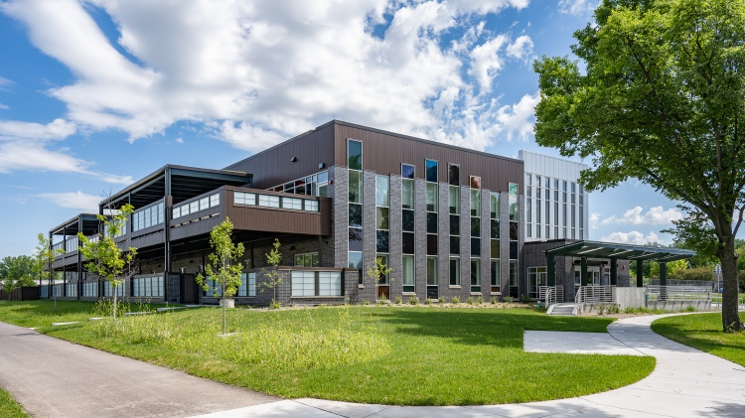
New Men’s Shelter on Bartillion
Located at 1904 Bartillion Dr
Opened on 9/1/26
250 beds across 6 dormitory spaces
Prioritizes access for the most vulnerable individuals.
Waitlist and Referral process are connected to Street Outreach and Day Shelter staff.

Slide 5
DCPN September 2026 links shared in the chat:
During the course of the webinar the following links were shared with participants:
  https://danesos.org/
  Email and phone number for shelter waitlist administrator: Shelterwaitlist@porchlightinc.org 608-814-8284
  Fares’s email: Ffares@porchlightinc.org

