Slide 1

Dane Crisis Provider Network Fireside chat
With 988, 911, Journey Crisis Line
Date: December 17, 2025
Topic: Who to Call
Presenters:
Chris Chun-Seely, Theresa Bednarek, Shelly Missel,
and Peter Zallar
Notes:
HIT RECORD!!!!!

Slide 2
Housekeeping reminders
All Webinars are recorded and saved to the DCPN webpage for reference
Encourage you to have your video on if you can
There will be time for questions- please ensure that you are maintaining client confidentiality
Notes:
Reminder to please stay on mute unless speaking. IF so, please note that you can raise your hand during the Q&A portion of this webinar.

Slide 3
DCPN December 2025 webinar objectives
At the end of this webinar, we hope that participants will understand…
  The best line to call during a crisis
  What to expect when calling
  Potential outcomes of the call
  How the lines may work together to resolve a crisis

Slide 4
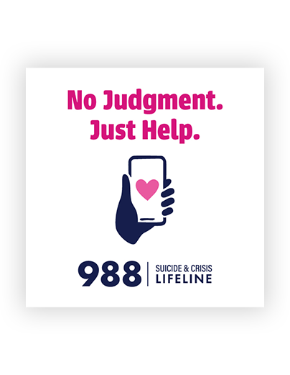
988
6,500-7,000 calls per month on average
2,200-2,500 texts/chats per month on average
January 1 to November 30th numbers:
Statewide Calls: 68,477
Dane County Calls: 5,173
Statewide Texts/Chats: 26,672
Dane County Texts/Chats: 1,058
Calls transferred to Local Crisis Programs: 427
Calls transferred to Dane: 37
Outside Interventions: 541
Dane Co Outside Interventions: 29

Slide 5
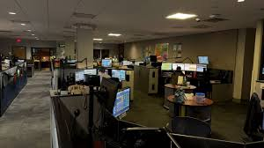

911
Total Calls in 2025
Non emergency: 187,289
  avg 16,786/month
To 911 166,438
  avg 15,130/month
CARES responses
3,915 in 2024
4,296 thru 12/4/25

Slide 6
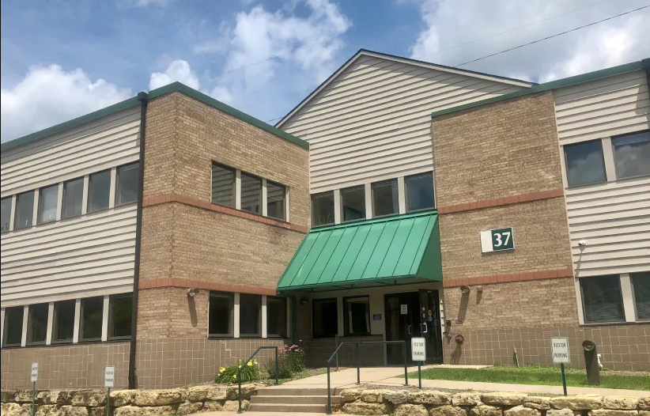


Journey Crisis Line
65, 126 calls last year
5,603 avg number of calls per month this year
Type of responses that can be dispatched:
Mobile Crisis Workers
Crisis Stabilizers for follow up
Expected Response:
Provide support, de-escalation, connection​
Provide guidance to family members/loved ones of someone experiencing mental health crisis​
Collaborate with service providers, law enforcement, etc.​
Assess risk of suicide/harm to self or others​
Identify level of care needed for person in crisis

Slide 7
